Slide 1
WELCOME
to our presentation

Slide 2

MD. SHOHIDUL ISLAM POLASH
Lecturer
Department of Computer Science & Engineering
Daffodil International University
Email: polash.cse@diu.edu.bd
Office: 316-6 (KT)

Slide 3





Let’s meet with our
Team Members
MIR AL SHAHRIYAR LIMON
242-15-811
REZOWAN AHAMED ABEER
242-15-315
TANVIR MAHATAB TANIM
242-15-893
JUNAYED AHMED
242-15-372
PARVEIZ AHMED ASHIK
242-15-213

Slide 4

Banking Management System: A Deep Dive into Code
This presentation will delve into the code behind the PPS Banking System, a robust and user-friendly application designed to provide a seamless banking experience. We will explore key features, functionalities, and underlying principles, providing a comprehensive understanding of its design and implementation.

Slide 5

Setting the Stage: Essential Libraries and Structures
Essential Libraries
User Structure
The code begins by including necessary libraries: stdio.h for standard input/output operations, string.h for string manipulation, stdlib.h for general utilities, and time.h for time-related functions.
The struct user defines a data structure to store essential user information, including phone number, account number, password, name, and balance.

Slide 6






Clearing the Screen: A Simple Utility
The clear_screen() function provides a cross-platform solution for clearing the console. It leverages the system() function to execute the appropriate command for different operating systems, ensuring a clean and visually appealing user interface.

Slide 7




Generating Unique Account Numbers
The generate_account_number() function utilizes the rand() function to generate a random six-digit number, prepended with "AC", ensuring a unique account number for each new user.

Slide 8

Secure Login: Verifying User Credentials
User Input
Account Verification
The login() function prompts the user to enter their phone number and password, storing the inputs for validation.
The function attempts to open a data file named after the entered phone number. If the file exists, the user's details are retrieved and validated against the entered password.

Slide 9
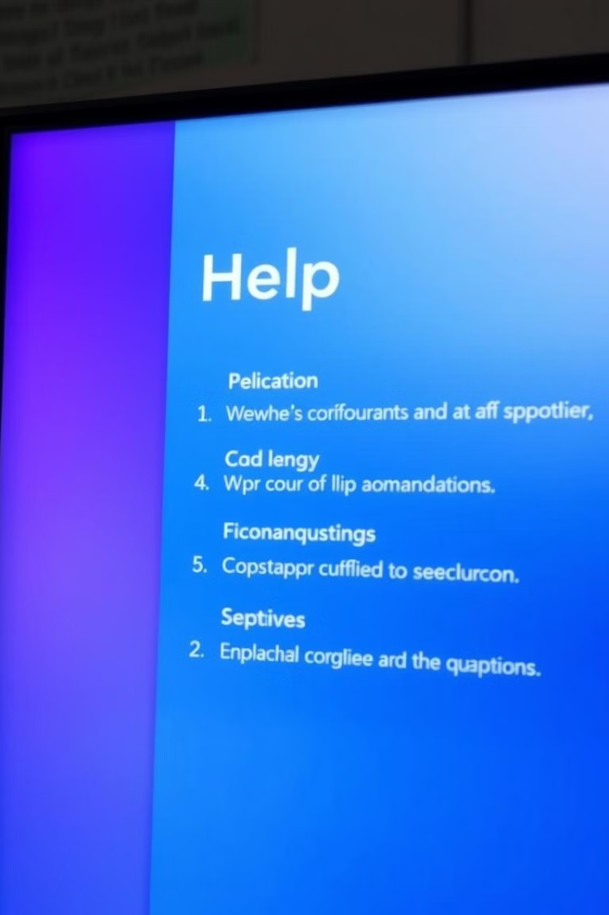
Comprehensive Help Zone: Accessing Key Features
The display_help() function displays a comprehensive menu outlining available features and functionalities. The menu includes options for balance inquiry, deposit, withdrawal, transfer, password change, and accessing the help zone itself.

Slide 10
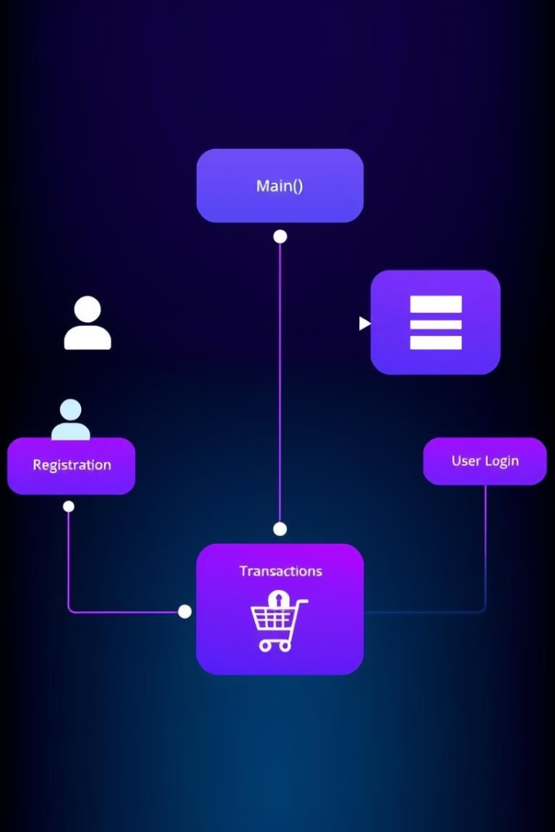


Main Function: The Heart of the System
1
Initialization
2
User Choice
The main() function begins by initializing variables, including a user structure, file pointers, and control variables.
The user is presented with the initial choice of registering a new account or logging into an existing one.

Slide 11
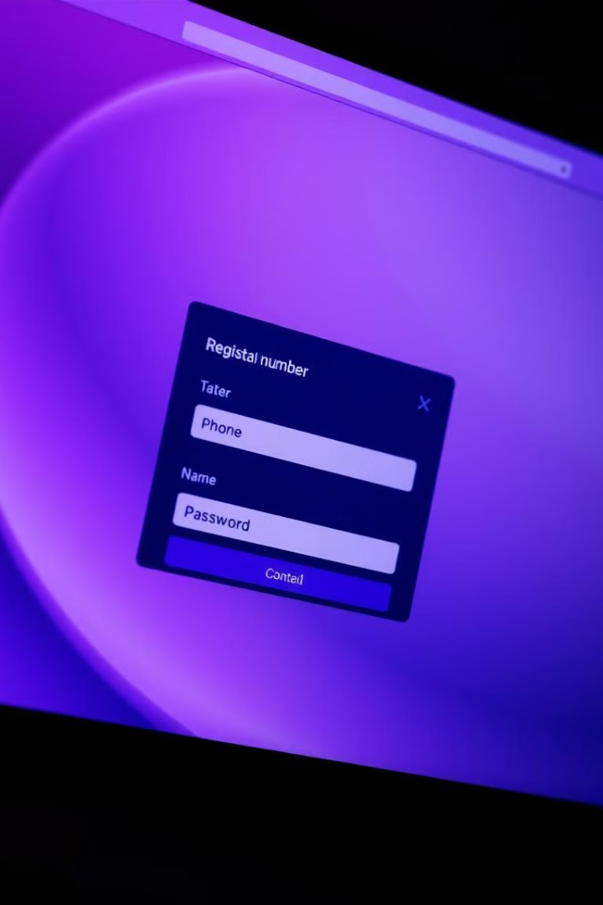

Account Registration: Setting Up a New Account
The registration process requires the user to enter their phone number, name, and desired password. The code then generates a unique account number and saves the user's information to a file named after their phone number.

Slide 12
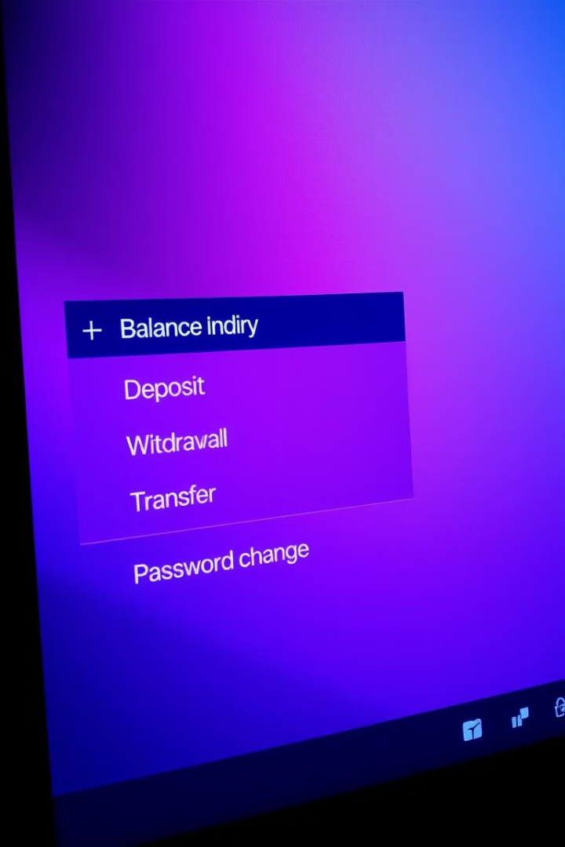
Banking Operations: A Range of Transactions
After successful login, the user gains access to various banking operations, including balance inquiry, deposit, withdrawal, online transfer, password change, and the help zone.

Slide 13


Security and Robustness: Key Principles
The PPS Banking System prioritizes security by employing secure file storage and password validation, ensuring data integrity and user protection. The code exhibits robust error handling, preventing unexpected behaviors and maintaining system stability.

